Slide 1
Data Development Utilizing Database Design and SQL
Day 5
Notes:
1

Slide 2
Querying Multiple Tables
Retrieve data from two or more tables in a single query.
Join tables
Use the same commands as for single-table queries

Slide 3
Joining Two Tables
SELECT clause
List all columns to display
FROM clause
List all tables involved in query
WHERE clause
Restrict to rows that have common values in matching columns

Slide 4
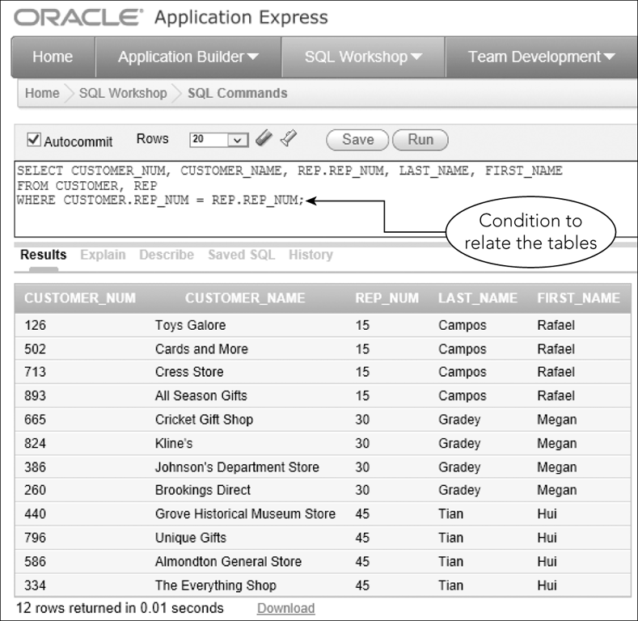
Joining Two Tables
Figure 5-1: Joining two tables with a single SQL command

Slide 5
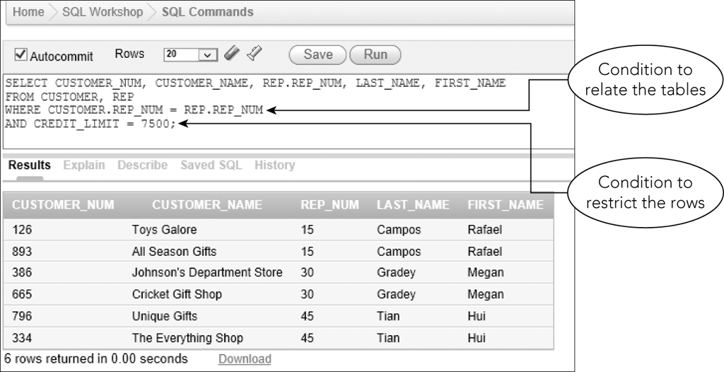
Joining Two Tables
Figure 5-2: Restricting the rows in a join

Slide 6
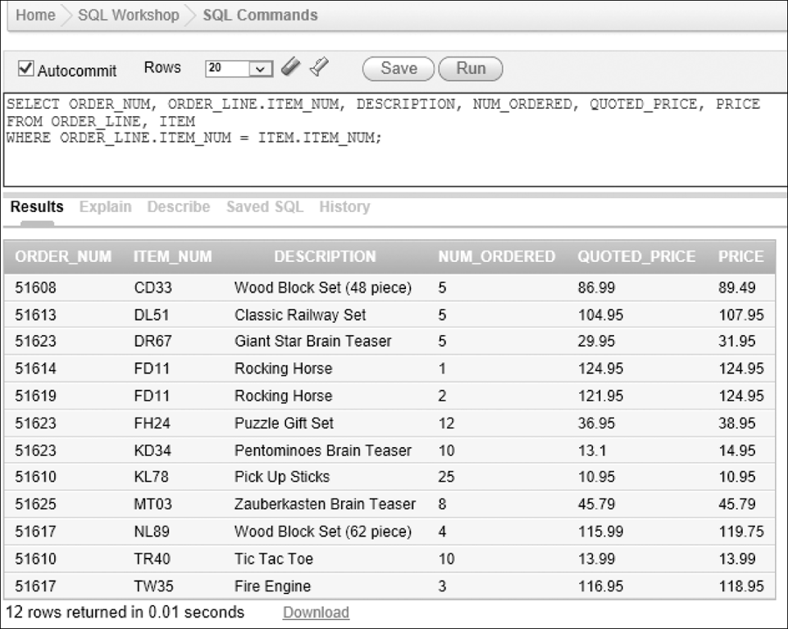
Joining Two Tables
Figure 5-3: Joining the ORDER_LINE and ITEM tables

Slide 7
Comparing JOINS, IN, and EXISTS
Can join tables using:
WHERE clause
IN operator with a subquery
EXISTS operator with a subquery

Slide 8
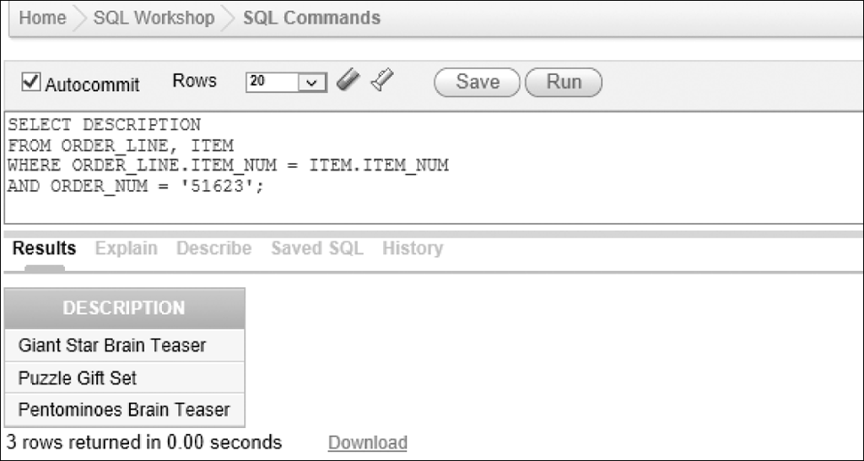
Comparing JOINS, IN, and EXISTS
WHERE clause
Figure 5-4: Restricting the rows when joining the ORDER_LINE and ITEM tables

Slide 9
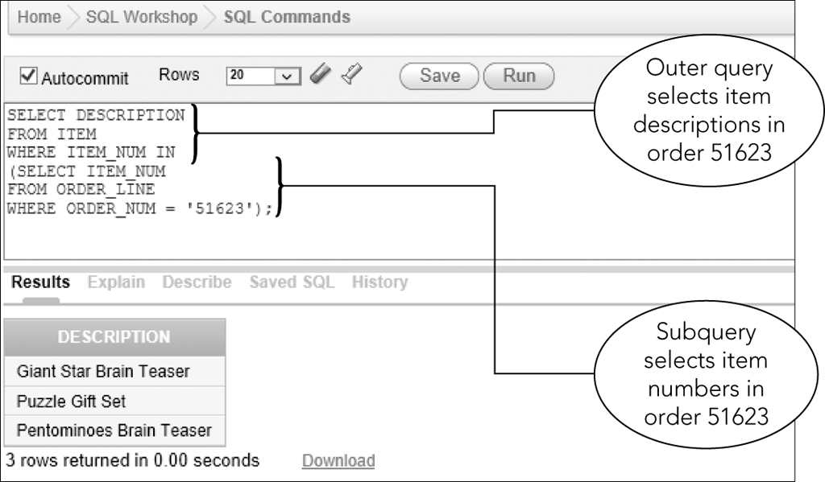
Using the IN Operator
Figure 5-5: Using the IN operator instead of a join to query two tables

Slide 10
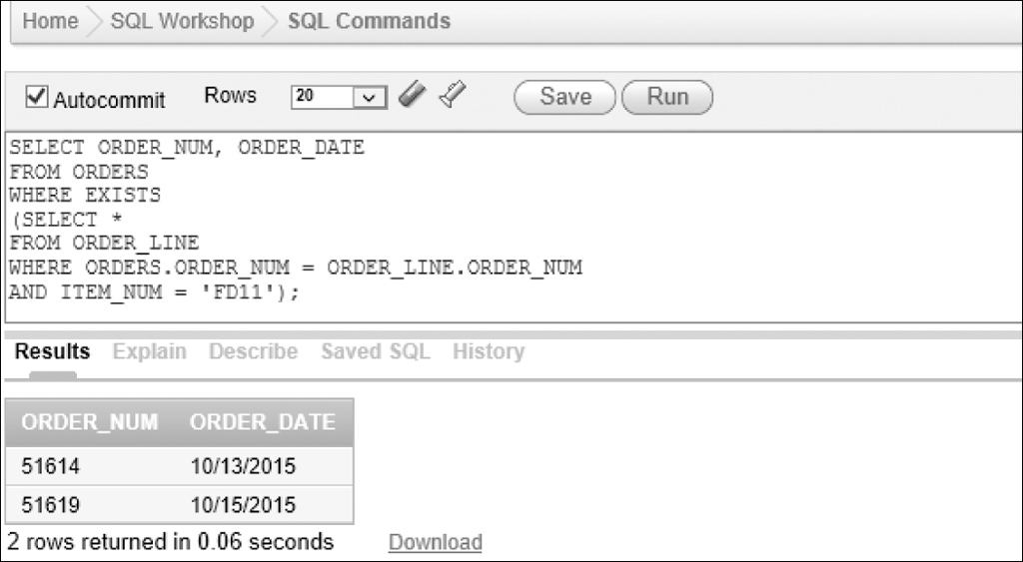
Using the EXISTS Operator
Figure 5-7 Using the EXISTS operator to select order information

Slide 11
Using the EXISTS Operator
Correlated subquery
Subquery involves a table listed in outer query
In Figure 5-7, the ORDERS table, listed in FROM clause of outer query used in subquery
Must qualify ORDER_NUM column in subquery as ORDERS.ORDER_NUM

Slide 12
Using a Subquery within a Subquery
Nested subquery is a subquery within a subquery
Evaluate from innermost query to outermost
More than one approach to formulating queries
Many DMBSs have optimizers that analyze queries for efficiency

Slide 13
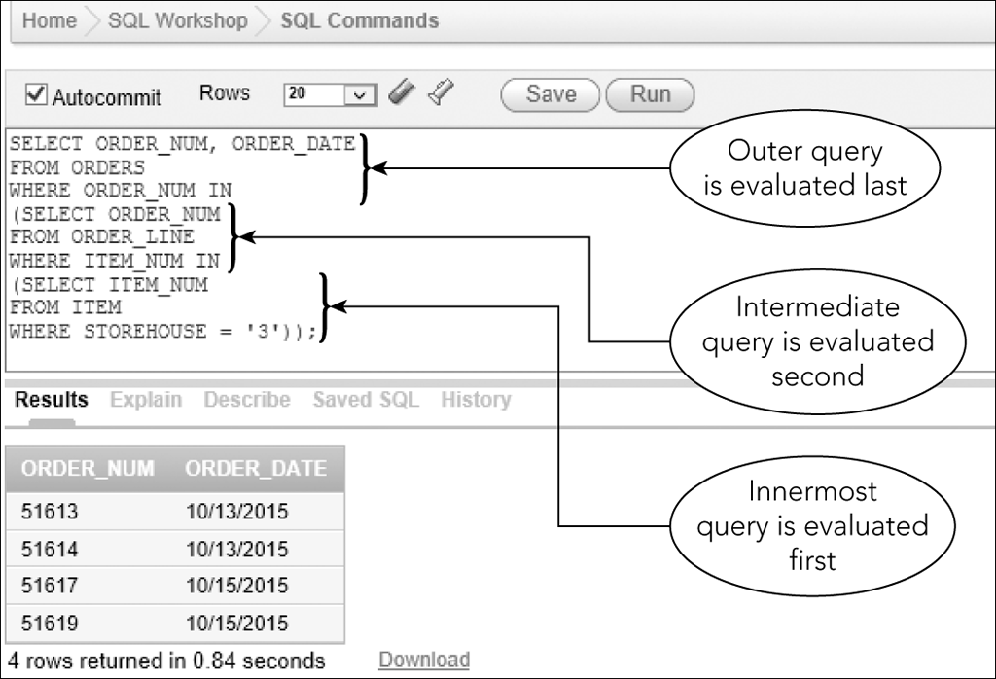
Using a Subquery within a Subquery
Figure 5-8: Nested subqueries (a subquery within a subquery)

Slide 14
Using a Subquery within a Subquery
Order of evaluating query
Innermost subquery first producing a temporary table
Next (intermediate) subquery producing a second temporary table
Outer query last producing final result

Slide 15
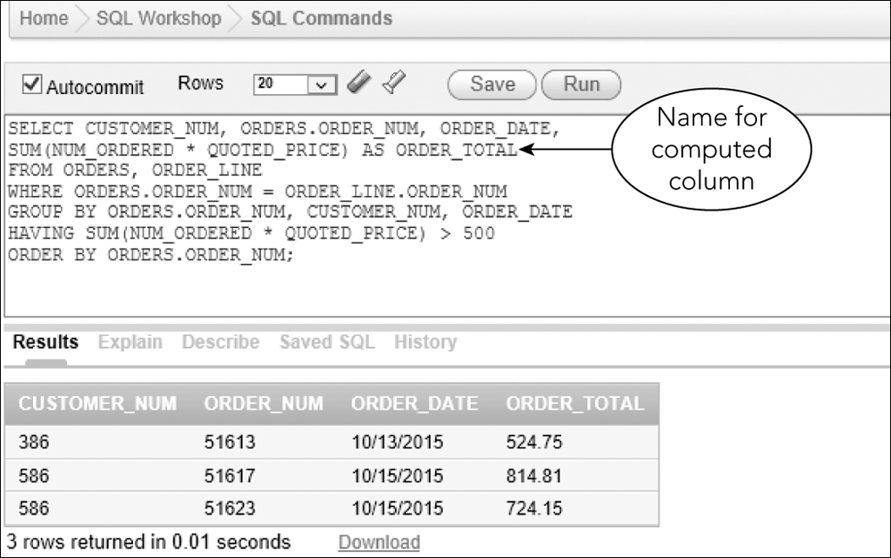
A Comprehensive Example
Figure 5-10 Comprehensive example

Slide 16
Using an Alias
An alternate name for a table
Use in FROM clause
Type name of table, press Spacebar, and then type name of alias
Allows for simplicity

Slide 17
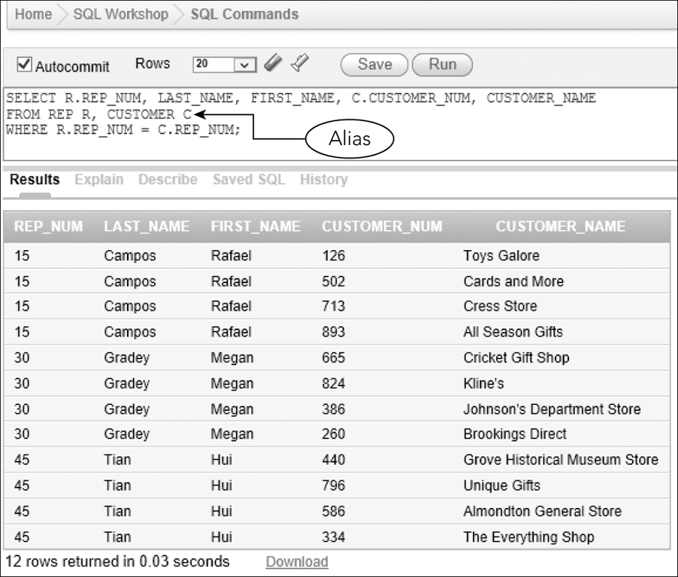
Using an Alias
Figure 5-11: Using aliases in a query

Slide 18
Joining a Table to Itself
Called a self-join
Use a different alias for same table
Use to compare records within one table
Treat one table as two separate tables by using alias

Slide 19
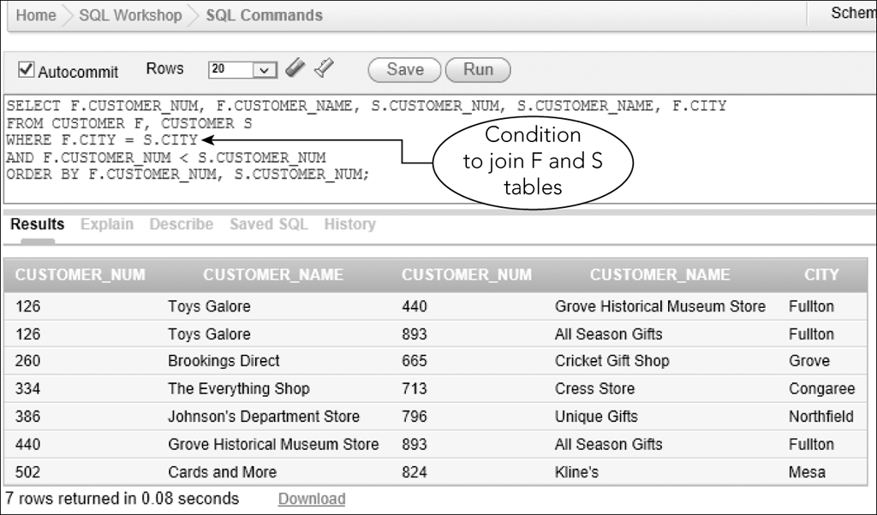
Joining a Table to Itself
Figure 5-12: Using aliases for a self-join

Slide 20
Using a Self-Join on a Primary Key
Can create a self-join that involves primary key of table
List table twice in FROM clause with aliases
Same as previous self-join example

Slide 21
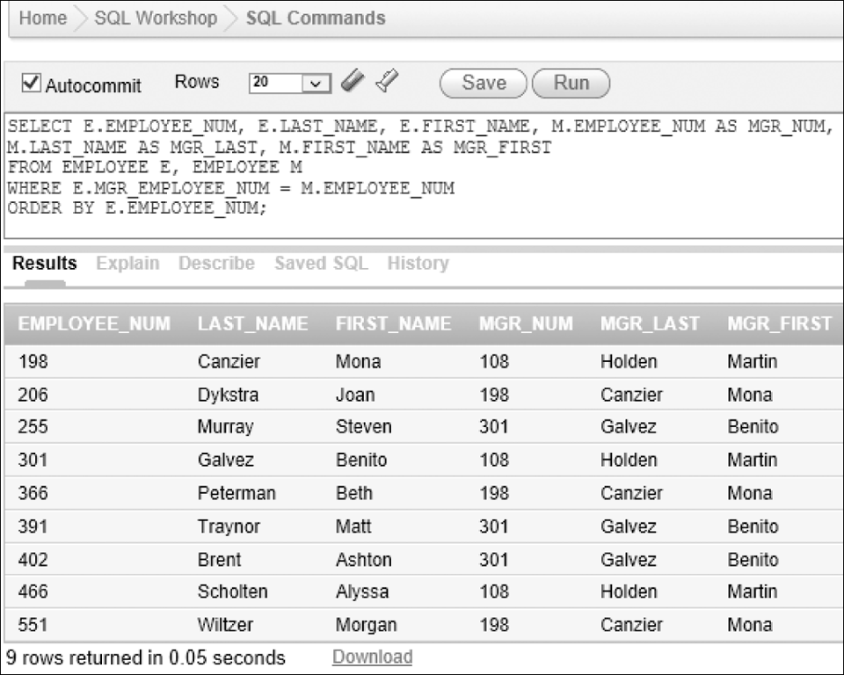
Using a Self-Join on a Primary Key
Figure 5-15: List of employees and their managers

Slide 22
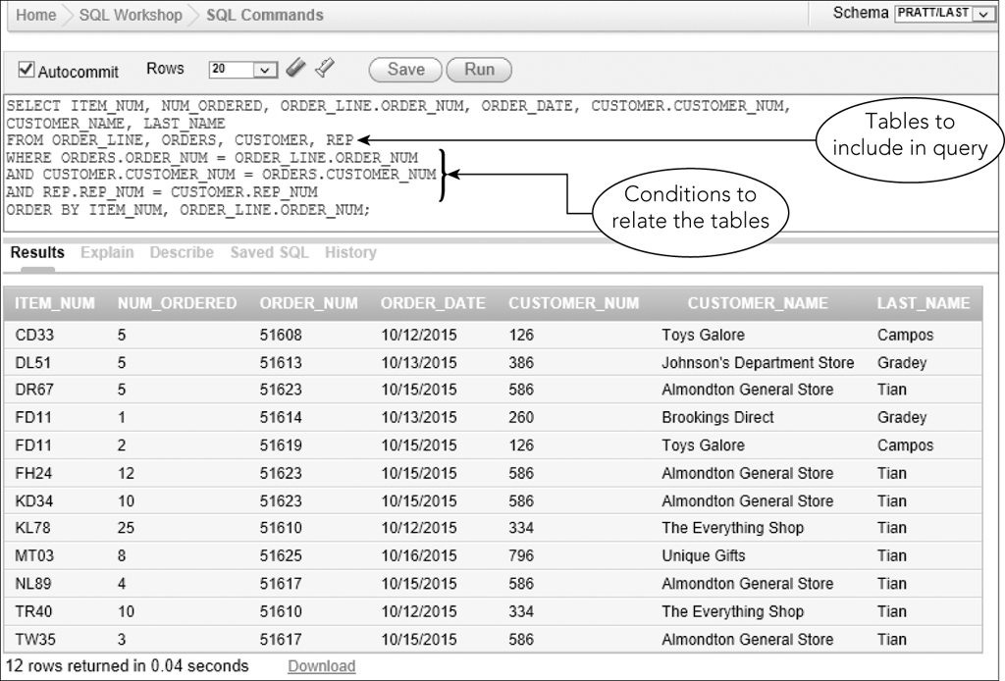
Joining Several Tables
Condition relates columns for each pair of tables
Figure 5-16: Joining four tables in a query

Slide 23
Joining Several Tables
In SELECT clause, list all columns to display
Qualify any column names if needed
In FROM clause, list all tables
Include tables used in the WHERE clause, even if they are not in the SELECT clause

Slide 24
Joining Several Tables
Take one pair of related tables at a time
Indicate in WHERE clause the condition that relates tables
Join conditions with AND operator
Include any additional conditions in WHERE clause
Connect them with AND operator

Slide 25
Exercise
Using the Colonial Adventure Tours (CAT) database (Figures 1-4 to 1-8 in the book) complete the following exercises:
For each reservation, list the reservation ID, trip ID, customer number and customer last name. Order by last name.
List the trip name of each trip that has Miles Abrams as a guide.
List the trip name of each Biking trip that has Rita Boyers as a guide.
List the reservation ID, trip ID and trip date for reservations for a trip in Maine.

Slide 26
Set Operations
Union
The union of two tables is a table containing every row that is in either the first table, the second table, or both tables
Use UNION operator
Tables must be union compatible; that is, the same number of columns and corresponding columns have identical data types and lengths

Slide 27
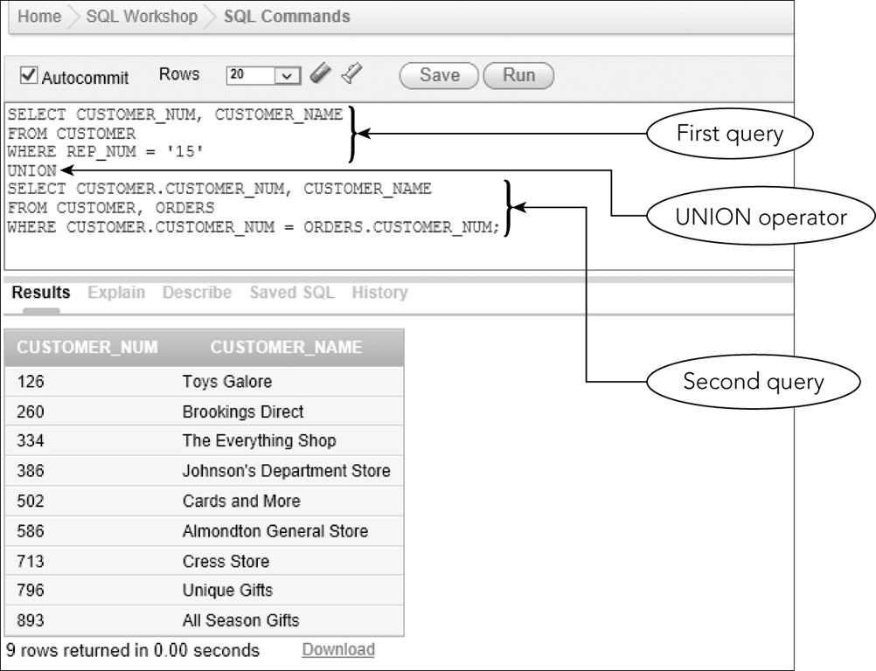
Set Operations
Figure 5-20: Using the UNION operator

Slide 28
Set Operations
Intersection
Intersection of two tables is a table containing all rows that are in both tables
Uses the INTERSECT operator
Not supported by Microsoft Access
Use an alternate approach

Slide 29
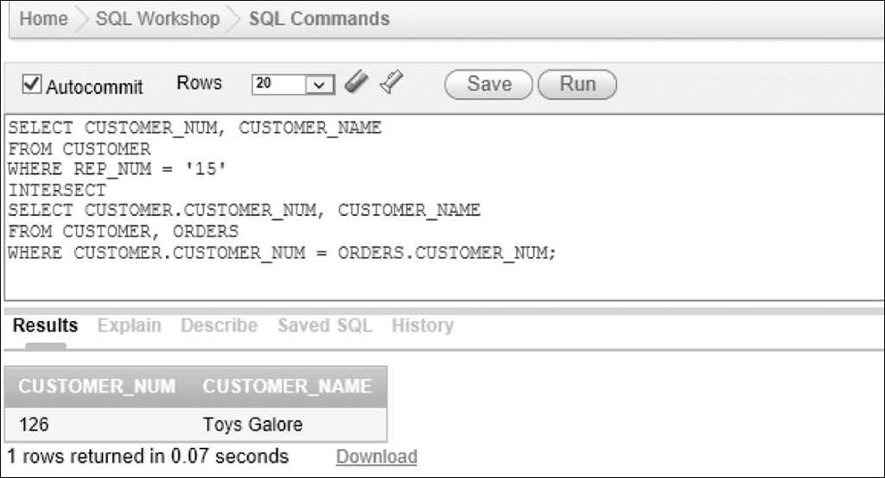
Set Operations
Figure 5-21: Using the INTERSECT operator

Slide 30
Set Operations
Difference
Difference of two tables is a table containing set of all rows that are in first table but not in second table
Uses the MINUS operator
Not supported by SQL Server and Microsoft Access
Use an alternate approach

Slide 31
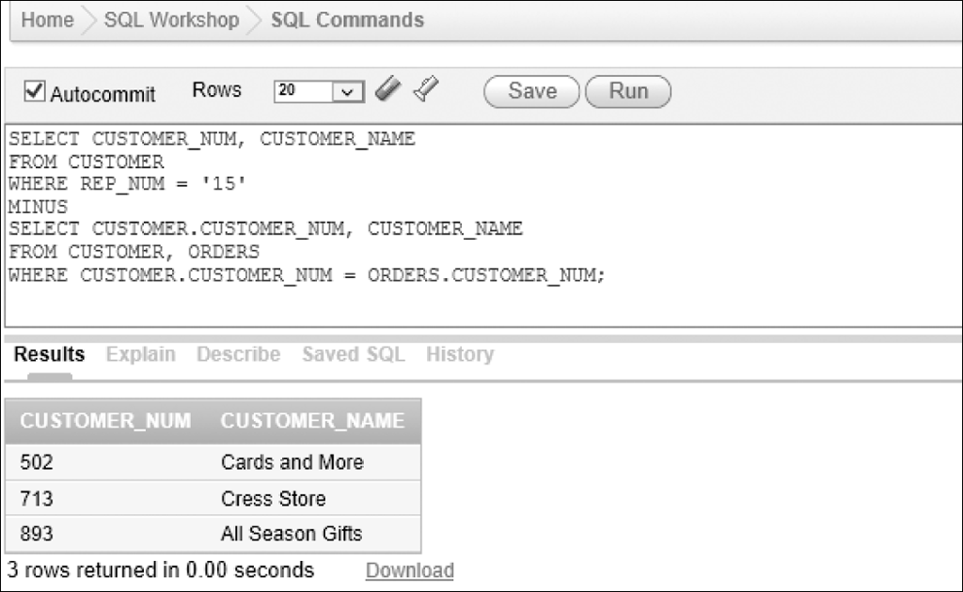
Set Operations
Figure 5-23: Using the MINUS operator

Slide 32
ALL and ANY
ALL operator
Condition is true only if it satisfies all values
ANY operator
Condition is true only if it satisfies any value
Precede subquery with appropriate operator

Slide 33
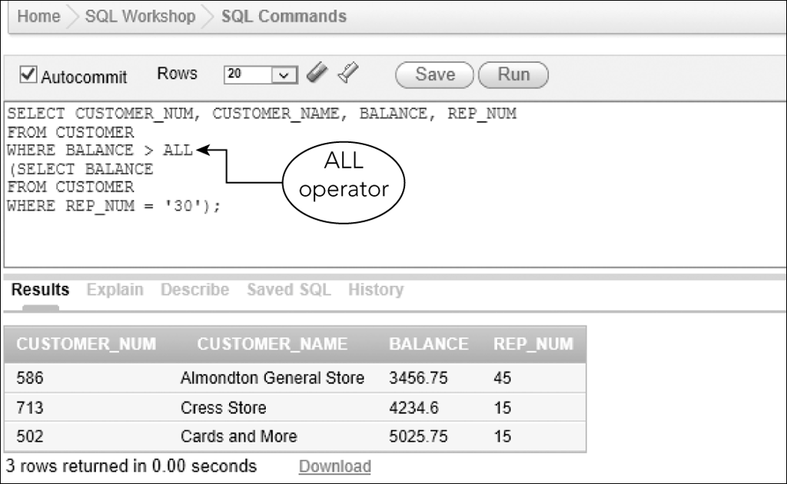
ALL and ANY
Figure 5-25: SELECT command that uses the ALL operator

Slide 34
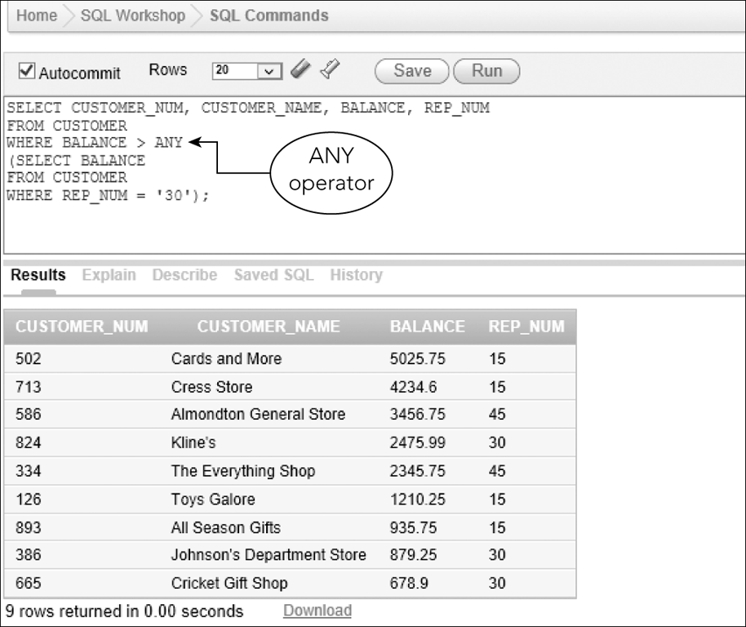
ALL and ANY
Figure 5-27: SELECT command with an ANY operator

Slide 35
Inner Join
Compares the tables in FROM clause and lists only those rows that satisfy condition in WHERE clause
INNER JOIN command
Update to SQL standard 1992

Slide 36
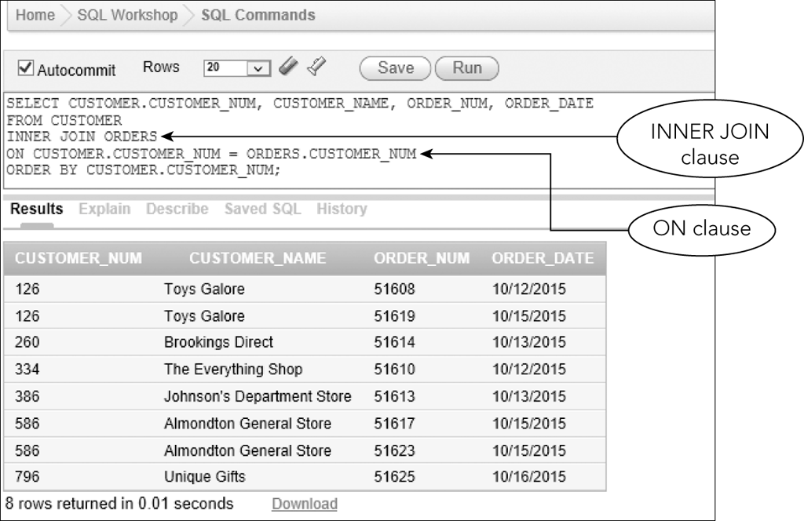
Inner Join
Figure 5-29: Query that uses and INNER JOIN clause

Slide 37
Outer Joins
Left outer join: all rows from the table on the left (listed first in the query) will be included; matching rows only from the table on the right will be included
Right outer join: all rows from the table on the right will be included; matching rows only from the table on the left will be included
Full outer join: all rows from both tables will be included regardless of matches

Slide 38
Summary
Join tables with WHERE clause
Join tables with IN operator
Join tables with EXISTS operator
A subquery can contain another subquery
Use an alias to simplify SQL command as well to create self-join
UNION, INTERSECT, MINUS
ALL and ANY operators
Inner join
Outer joins: Left, Right and Full

Slide 39
Exercise
Using the Solomaris Condominium Group (SCG) database (Figures 1-9 to 1-13 in the book) complete the following exercises:
If you do not have the SCG tables and data created, create them first.
For every condo, list the location number, unit number, condo fee, owner number, owner’s first and last name
List the square footage, owner number, owner first and last name for each condo with three bedrooms.
List the condo ID, square footage, owner number, service ID, number of estimated hours and number of spent hours for each service request with category number 4. Make sure each condo is included regardless of whether the condo currently has any service requests for category 4.

